Slide 1
College Technical Math 1
Section 9.3
Slope

Slide 2
Slope of a Line
$$Slope of a line=$$

Slide 3
Slope of a Line
$$Slope of a line=$$
$$=rate of change (two quantities)$$

Slide 4
Slope of a Line
$$Slope of a line=$$
$$=rate of change (two quantities)$$
$$=\frac{change in quantity 2}{change in quantity 1}$$

Slide 5
Slope of a Line
$$Slope of a line=$$
$$=rate of change (two quantities)$$
$$=\frac{change in quantity 2}{change in quantity 1}$$
$$=\frac{rise}{run}$$

Slide 6
Slope of a Line
$$Slope of a line=$$
$$=rate of change (two quantities)$$
$$=\frac{change in quantity 2}{change in quantity 1}$$
$$=\frac{rise}{run}=\frac{vertical change}{horizontal change}$$

Slide 7
Slope of a Line
$$Slope of a line=$$
$$=rate of change (two quantities)$$
$$=\frac{change in quantity 2}{change in quantity 1}$$
$$=\frac{rise}{run}=\frac{vertical change}{horizontal change}$$
$$=\frac{y_{2}−y_{1}}{x_{2}−x_{1}}$$

Slide 8
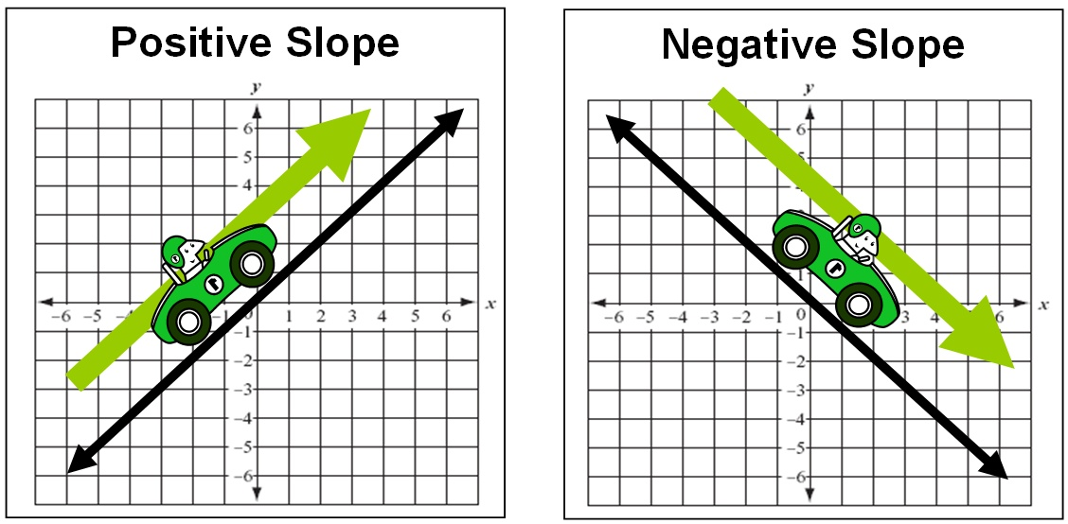
Slope of a Line
Lines that point up when going left to right are said to have a positive slope.

Slide 9
Slope of a Line
Lines that point down when going left to right are said to have a negative slope.

Slide 10
Slope of a Line
Can you see the difference?

Slide 11
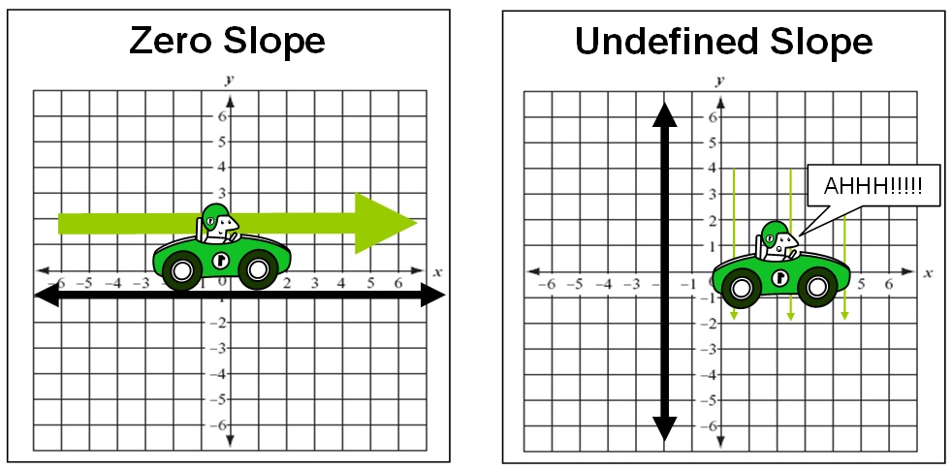
Slope of a Line
Lines that go horizontally when going left to right are said to have a slope of 0.

Slide 12
Slope of a Line
Lines that go vertically when going left to right are said to have an undefined slope.

Slide 13
Slope of a Line
Can you see the difference.

Slide 14
Slope of a Line
Determine the slope of the highlighted segment of each letter. (Skill Check)
positive

Slide 15
Slope of a Line
Determine the slope of the highlighted segment of each letter. (Skill Check)
negative

Slide 16
Slope of a Line
Determine the slope of the highlighted segment of each letter. (Skill Check)
zero

Slide 17
Slope of a Line
Determine the slope of the highlighted segment of each letter. (Skill Check)
zero

Slide 18
Slope of a Line
Determine the slope of the highlighted segment of each letter. (Skill Check)
zero

Slide 19
Slope of a Line
Determine the slope of the highlighted segment of each letter. (Skill Check)
undefined

Slide 20
Slope of a Line
Determine the slope of the highlighted segment of each letter. (Skill Check)
negative

Slide 21
Slope of a Line
Determine the slope of the highlighted segment of each letter. (Skill Check)
positive

Slide 22
Slope of a Line
Determine the slope of the highlighted segment of each letter. (Skill Check)
negative

Slide 23
Slope of a Line
Determine the slope of the highlighted segment of each letter. (Skill Check)
positive

Slide 24
Slope of a Line - Graph
$$slope=\frac{rise}{run}$$

Slide 25
Slope of a Line - Graph
$$slope=\frac{rise}{run}$$
Identify two points on the graph of the line.

Slide 26
Slope of a Line - Graph
$$slope=\frac{rise}{run}$$
Identify two points on the graph of the line.
Draw a rectangle using the points as two of the corners of the rectangle.

Slide 27
Slope of a Line - Graph
$$slope=\frac{rise}{run}$$
Identify two points on the graph of the line.
Draw a rectangle using the points as two of the corners of the rectangle.
Use one of the triangles of the rectangle to determine the rise and run.

Slide 28
Slope of a Line - Graph
$$slope=\frac{rise}{run}$$
Identify two points on the graph of the line.
Draw a rectangle using the points as two of the corners of the rectangle.
Use one of the triangles of the rectangle to determine the rise and run.
Write the slope as the ratio of $\frac{rise}{run}$

Slide 29
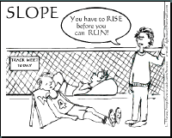

Slide 30
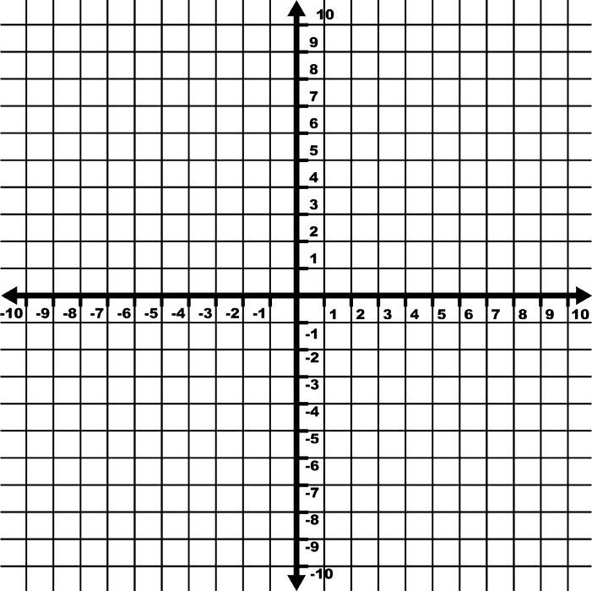
Determine the slope of the line. (Example)
$$Slope=\frac{rise}{run}$$
$$Slope=\frac{−3}{6}=−\frac{1}{2}$$
$$Slope=\frac{3}{−6}=−\frac{1}{2}$$

Slide 31
Determine the slope of the line. (Example)
$$Slope=\frac{rise}{run}$$
$$Slope=\frac{7}{7}=1$$
$$Slope=\frac{−7}{−7}=1$$

Slide 32
Determine the slope of the line. (Example)
$$Slope=\frac{rise}{run}$$
$$Slope=\frac{0}{9}=0$$

Slide 33
Determine the slope of the line. (Example)
$$Slope=\frac{rise}{run}$$
$$Slope=\frac{11}{0}=undefined$$

Slide 34
Determine the slope of the line. (Skill Check)
$$Slope=\frac{5}{10}=\frac{1}{2}$$

Slide 35
Determine the slope of the line. (Skill Check)
$$Slope=\frac{−7}{3}=−\frac{7}{3}$$

Slide 36
Slope of a Line - Graphing
The slope of a line can be used to graph a line.
To graph a line using a point on the line and the slope:
Plot the point.
Starting at the plotted point use the rise and run to locate a second point on the graph of the line.
Connect the two points to form the line.

Slide 37
Slope of a Line - Graphing
A line contains a point $\left(−3,4\right)$ and a slope of $−\frac{6}{5}$. Graph the line. (Example)

Slide 38
Slope of a Line - Graphing
A line contains a point $\left(−3,4\right)$ and a slope of $−\frac{6}{5}$. Graph the line. (Example)
Plot the point $\left(−3,4\right)$

Slide 39
Slope of a Line - Graphing
A line contains a point $\left(−3,4\right)$ and a slope of $−\frac{6}{5}$
. Graph the line. (Example)
The slope is $−\frac{6}{5}=\frac{−6}{5}=\frac{6}{−5}$
We can use a rise of $−6$ and run of $5$ to plot our second point.

Slide 40
Slope of a Line - Graphing
A line contains a point $\left(−3,4\right)$ and a slope of $−\frac{6}{5}$
. Graph the line. (Example)
The slope is $−\frac{6}{5}=\frac{−6}{5}=\frac{6}{−5}$
Or, we can use a rise of $6$ and run of $−5$ to plot our second point.

Slide 41
Slope of a Line - Graphing
A line contains a point $\left(−3,4\right)$ and a slope of $−\frac{6}{5}$
. Graph the line. (Example)
The slope is $−\frac{6}{5}=\frac{−6}{5}=\frac{6}{−5}$
Either way, the points will form the same line.

Slide 42
Slope of a Line - Graphing
A line contains a point $\left(0−7\right)$ and a slope of $5$. Graph the line. (Example)

Slide 43
Slope of a Line - Graphing
A line contains a point $\left(0−7\right)$ and a slope of $5$. Graph the line. (Example)
Plot the point $\left(0,−7\right)$

Slide 44
Slope of a Line - Graphing
A line contains a point $\left(0−7\right)$ and a slope of $5$. Graph the line. (Example)
The slope is $5=\frac{5}{1}=\frac{−5}{−1}$
We can use a rise of $5$and run of $1$ to plot our second point.

Slide 45
Slope of a Line - Graphing
A line contains a point $\left(0−7\right)$ and a slope of $5$. Graph the line. (Example)
The slope is $5=\frac{5}{1}=\frac{−5}{−1}$
We can use a rise of $−5$and run of $−1$ to plot our second point.

Slide 46
Slope of a Line - Graphing
A line contains a point $\left(0−7\right)$ and a slope of $5$. Graph the line. (Example)
The slope is $5=\frac{5}{1}=\frac{−5}{−1}$
Either way, the points will form the same line.

Slide 47
The slope and y intercept of a linear equation can be determined directly from the equation when the equation is written in slope intercept form.
The constant is the
y coordinate of the
y intercept. (0, b)
y must be isolated and
have a coefficient of 1.
The coefficient of the
x term is the slope.

Slide 48
Example: Determine the slope and y intercept of each linear equation.
Linear Equation | Slope | Y intercept
$$y=−3x+5$$ | $$−3$$ | $$(0,5)$$
$$y=\frac{5}{2}x−6$$ | $$\frac{5}{2}$$ | $$(0,−6)$$
$$y=x+11$$ | $$1$$ | $$(0,11)$$
$$y=−\frac{8}{3}+3x$$ | $$3$$ | $$\left(0,−\frac{8}{3}\right)$$

Slide 49
Write the equation in slope intercept form and then identify the slope and y intercept. (Example)
$$−2x+y=−7$$
$$Slope=2$$
$$y=−7+2x$$
$$y −int: (0,−7)$$
$$y=2x−7$$

Slide 50
Write the equation in slope intercept form and then identify the slope and y intercept. (Example)
$$Slope=−\frac{3}{5}$$
$$3x+5y=8$$
$$5y=8−3x$$
$$y −int: \left(0,\frac{8}{5}\right)$$
$$y=\frac{8}{5}−\frac{3}{5}x$$
$$y=−\frac{3}{5}x+\frac{8}{5}$$

Slide 51
Write the equation in slope intercept form and then identify the slope and y intercept. (Example)
$$\left(a\right) x+2y=8$$
$$y=−\frac{1}{2}x+4 Slope=−\frac{1}{2} y −int:(0,4)$$
$$\left(b\right) −5x+y=−4$$
$$y=5x−4 Slope=5 y −int:(0,−4)$$

Slide 52
Write the equation in slope intercept form and then identify the slope and y intercept. (Example)
$$\left(c\right) −6x−2y=0$$
$$y=−3x Slope=−3 y −int:(0,0)$$
$$\left(d\right) −4y+3x=−4$$
$$y=\frac{3}{4}x+1 Slope=\frac{3}{4} y −int:(0,1)$$

Slide 53
Calculating Slope – Two Points
The slope of a line represents the rate of change between the dependent and independent variables.
Often we have two data points and want to calculate this rate of change without having the graph of the line or the equation.
To complete this calculation we use the slope formula.

Slide 54
Calculating Slope – Two Points
$$slope=\frac{Second y value −First y value}{Second x value −First x value}$$

Slide 55
Calculating Slope – Two Points
$$slope=\frac{Second y value −First y value}{Second x value −First x value}$$
$$=\frac{y_{2}−y_{1}}{x_{2}−x_{1}}$$

Slide 56
Calculating Slope – Two Points
$$slope=\frac{Second y value −First y value}{Second x value −First x value}$$
$$=\frac{y_{2}−y_{1}}{x_{2}−x_{1}}$$
Label the coordinates of the first point $(x_{1},y_{1})$

Slide 57
Calculating Slope – Two Points
$$slope=\frac{Second y value −First y value}{Second x value −First x value}$$
$$=\frac{y_{2}−y_{1}}{x_{2}−x_{1}}$$
Label the coordinates of the first point $\left(x_{1},y_{1}\right)$
Label the coordinates of the second point $(x_{2}, y_{2})$

Slide 58
Calculating Slope – Two Points
$$slope=\frac{Second y value −First y value}{Second x value −First x value}$$
$$=\frac{y_{2}−y_{1}}{x_{2}−x_{1}}$$
Label the coordinates of the first point $\left(x_{1},y_{1}\right)$
Label the coordinates of the second point $\left(x_{2}, y_{2}\right)$
Substitute the values for $y_{2}, y_{1}, x_{2},$ and $x_{1}$ into the slope formula to calculate the slope

Slide 59
Calculating Slope – Two Points
Calculate the slope of a line containing the points
$(3, 2)$ and $(7,9)$

Slide 60
Calculating Slope – Two Points
Calculate the slope of a line containing the points
$(3, 2)$ and $(7,9)$
$(3, 2)$ $(7,9)$

Slide 61
Calculating Slope – Two Points
Calculate the slope of a line containing the points
$(3, 2)$ and $(7,9)$
$$x_{1}$$
$(3, 2)$ $(7,9)$

Slide 62
Calculating Slope – Two Points
Calculate the slope of a line containing the points
$(3, 2)$ and $(7,9)$
$$x_{1},y_{1}$$
$(3, 2)$ $(7,9)$

Slide 63
Calculating Slope – Two Points
Calculate the slope of a line containing the points
$(3, 2)$ and $(7,9)$
$$x_{1},y_{1} x_{2}$$
$(3, 2)$ $(7,9)$

Slide 64
Calculating Slope – Two Points
Calculate the slope of a line containing the points
$(3, 2)$ and $(7,9)$
$$x_{1},y_{1} x_{2},y_{2}$$
$(3, 2)$ $(7,9)$
$$slope=\frac{9−2}{7−3}$$
$$=\frac{7}{4}$$

Slide 65
Calculating Slope – Two Points
Calculate the slope of a line containing the points
$(−4, 3)$ and $(0,−2)$

Slide 66
Calculating Slope – Two Points
Calculate the slope of a line containing the points
$(−4, 3)$ and $(0,−2)$
$(−4, 3)$ $(0,−2)$

Slide 67
Calculating Slope – Two Points
Calculate the slope of a line containing the points
$(−4,3)$ and $(0,−2)$
$$x_{1}$$
$(−4, 3)$ $(0,−2)$

Slide 68
Calculating Slope – Two Points
Calculate the slope of a line containing the points
$(−4,3)$ and $(0,−2)$
$$x_{1},y_{1}$$
$(−4, 3)$ $(0,−2)$

Slide 69
Calculating Slope – Two Points
Calculate the slope of a line containing the points
$(−4,3)$ and $(0,−2)$
$$x_{1},y_{1} x_{2}$$
$(−4, 3)$ $(0,−2)$

Slide 70
Calculating Slope – Two Points
Calculate the slope of a line containing the points
$(−4,3)$ and $(0,−2)$
$$x_{1},y_{1} { x}_{2},y_{2}$$
$(−4, 3)$ $(0,−2)$
$$slope=\frac{−2−3}{0−(−4)}$$
$$=\frac{−5}{4}=−\frac{5}{4}$$

Slide 71
Calculating Slope – Two Points
Note: If the x coordinates of the points are the same,
$(3,4)$ and $(3,−7)$
the slope of the line will be undefined.
$slope=\frac{−7−4}{3−3}=\frac{−11}{0} undefined$

Slide 72
Calculating Slope – Two Points
Note: If the y coordinates of the points are the same,
$(4,1)$ and $(−3,1)$
the slope of the line will be 0.
$slope=\frac{1−1}{−3−4}=\frac{0}{−7}=0$

Slide 73
Calculating Slope – Two Points
Calculate the slope of a line that contains the given points. (Skill Check)
$$\left(a\right) \left(−3,2\right) and \left(9,1\right) m=−\frac{1}{12}$$
$$\left(b\right) \left(0,−2\right) and \left(5,7\right) m=\frac{9}{5}$$

Slide 74
Calculating Slope – Two Points
Calculate the slope of a line that contains the given points. (Skill Check)
$$\left(c\right) \left(4,4\right) and \left(−3,−10\right) m=2$$
$$\left(d\right) \left(\frac{1}{5},−\frac{3}{4}\right) and \left(4\frac{2}{5},−1\frac{1}{8}\right) m=−\frac{5}{56}$$

